Slide 1
Bipedal Walker
Nguyen Quoc Anh

Slide 2
Content
Evolutionary Algorithm
DDPG
Reward Modification

Slide 3
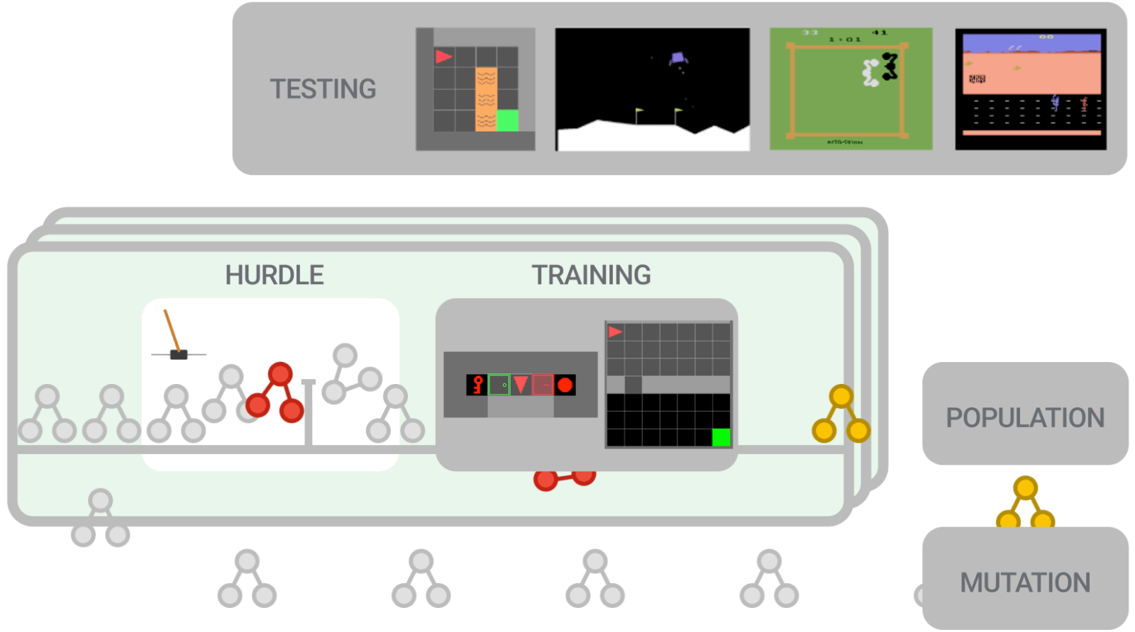
1. Evolutionary Algorithm (EvoAlg)
Source: [8]
Evolve the nn that maps state to actions
Start with 48 agents of new generation, for each, run 3 episodes to get average rewards
Pick 25% pass to next gen
Pick 75% (randomly, prob weighted to reward) to breed (new weights chosen from parents) and mutate (10% new weights added with random noise) and create children for next gen
Repeat from step 1, till gen 40

Slide 4
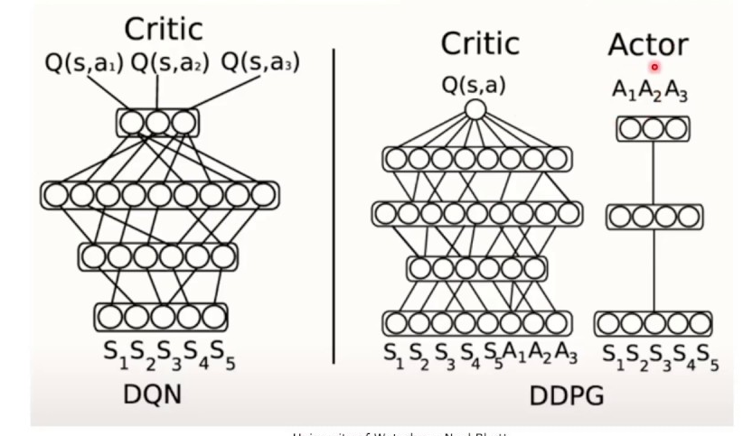
2. Deep Deterministic Policy Gradients (DDPG)
Actor: Trained to output actions that maximize Q value
Critic: Trained to minimize Mean Squared Bellman Error, get better Q value estimation
Source: [9]

Slide 5
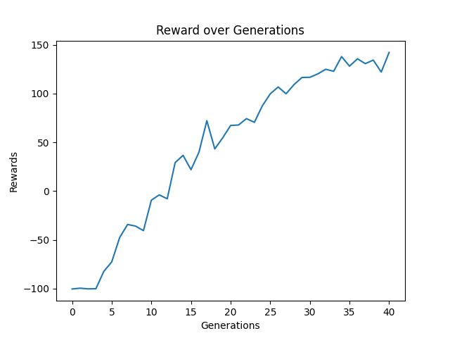
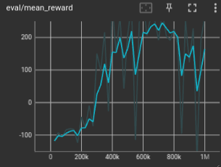
2. DDPG
EvoAlg | DDPG
11 hours for 48 agents/gen, 40 generations | 2.5 hours for 1,000,000 timesteps
*Training on CPU, of the same machine

Slide 6

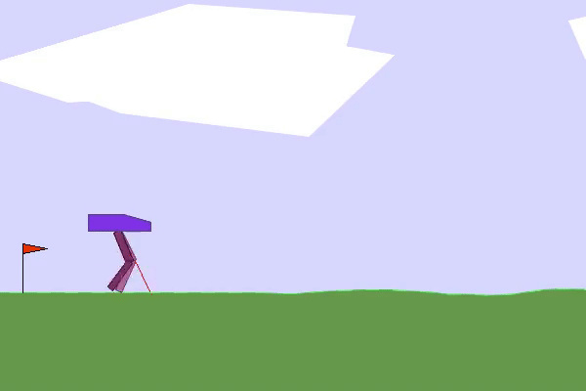
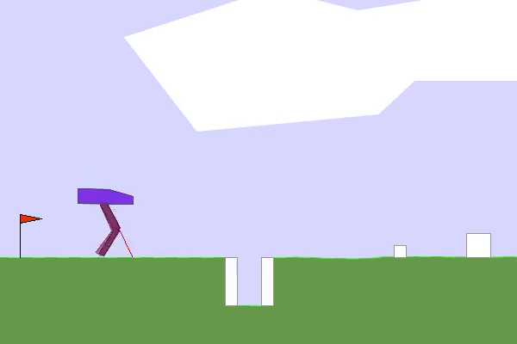
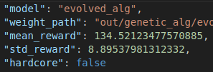
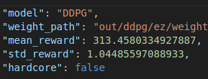
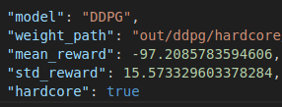
2. DDPG: on EZ and Hardcore results
EvoAlg on EZ DDPG on EZ DDPG on Hardcore

Slide 7
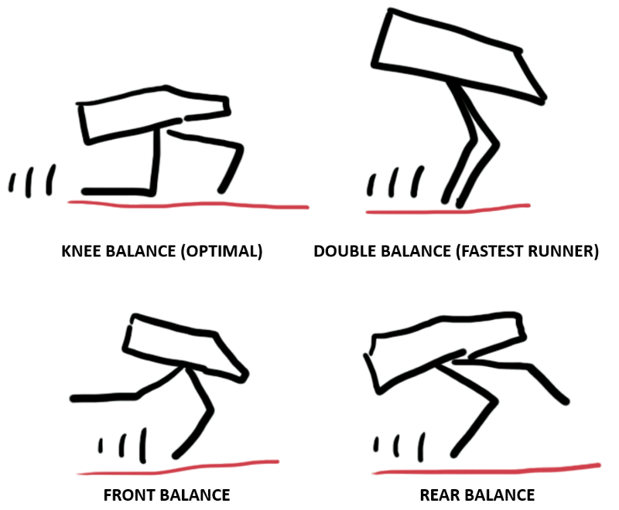
3. Reward Modification
Related Works: Sparse vs Dense
Found solutions:
Source: [5]
Default Reward System:
Reward when move forth
Punish when use any motor torque
Punish when tilt angle != 0
Punish when falls -> stops game
Source: [6]

Slide 8
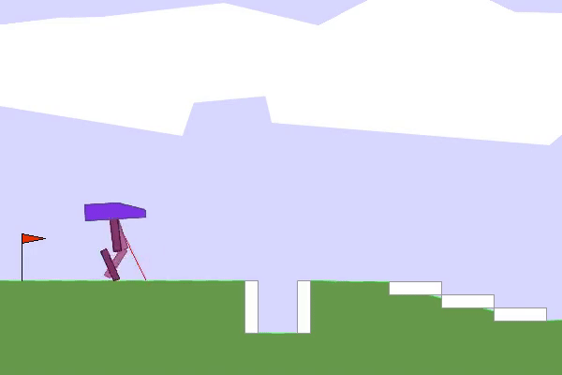
3. Reward Modification: Problems to solve
Idle | Slow because of balancing (Bicycle)
Still waits till 1600 steps | Doesn’t look like how normal humans walk

Slide 9

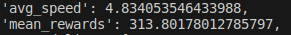
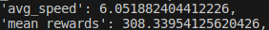
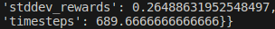
3. Reward Modification: No Idle + Run Faster
Baseline | Run Faster
Used to extract average speed threshold | Reward/punish 4 over/under speed threshold

Slide 10

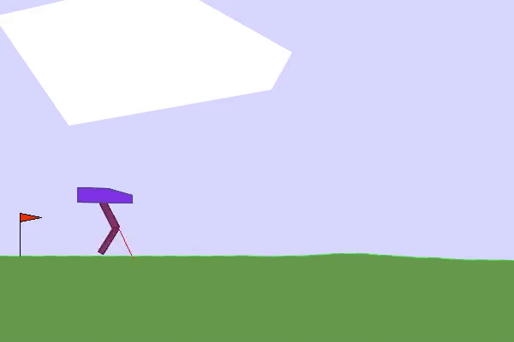
3. Reward Modification: Hopping + Jump Higher
Baseline | NoLeg0Contact | JumpHigher
DDPG on EZ No Reward Modification | Deduct points for not having 1 leg contact at all times. Reward points ¼ for keeping leg not contact | Deduct points for being under a height threshold. Reward points for being above
Gave up hopping and just ran really fast to minimize leg contact time
Doesn’t jump, but hop and run in small steps to keep the hull higher

Slide 11
3. Reward Modification: Possible Todos
Induce Hopping: Reward for height of leg joint, not no-contact-of-leg
Lessen Balancing requirements: Only punish if hull angle is outside of [-pi/6, pi/6]. This will make the agent explore more diverse policy in hardcore environment
Further tuning of rewards
Add more to the state/observations

Slide 12
References:
[1] Fujimoto, S.; Hoof, H.V.; Meger, D. 2018. Addressing Function Approximation Error in Actor-Critic Methods. ArXiv, abs/1802.09477.
[2] Peter Henderson et al. Deep Reinforcement Learning that Matters. 2019. arXiv: 1709. 06560 [cs.LG].
[3] Honghao Wei and Lei Ying. “FORK: A Forward-Looking Actor For Model-Free Reinforcement Learning”. In: CoRR abs/2010.01652 (2020). arXiv: 2010.01652. url: https://arxiv.org/abs/2010.01652.
[4] Schulman, J., Moritz, P., Levine, S., Jordan, M., & Abbeel, P. (2015). High-dimensional continuous control using generalized advantage estimation. arXiv preprint arXiv:1506.02438.
[5] PyLessons, “Bipedalwalker-V3 with Continuous Proximal Policy Optimization.” pylessons.com/BipedalWalker-v3-PPO. Accessed 18 Nov. 2023.
[6] PIERRÉ, A. GitHub OpenAI’s gym Available at: https://github.com/openai/gym/blob/master/gym/envs/box2d/bipedal_walker.py (Accessed: 18 November 2023).
[7] Timothy P. Lillicrap, Jonathan J. Hunt, Alexander Pritzel, Nicolas Heess, Tom Erez, Yuval Tassa, David Silver, and Daan Wierstra. Continuous control with deep reinforcement learning, 2019.
[8] Evolving Reinforcement Learning Algorithms: 2021. https://blog.research.google/2021/04/evolving-reinforcement-learning.html.
[9] Neel Bhatt. “CS885 Reinforcement Learning: DDPG End-to-End Autonomous Parking - Neel Bhatt.” YouTube, July 31, 2022. https://www.youtube.com/watch?v=3LFkAiV50FQ.

